Slide 1
Shared Memory Synchronization
CS121 Parallel Computing
Spring 2018

Slide 2
Concurrency bugs
In parallel system, high performance achieved by using algorithm with high parallelism, good load balancing, memory locality, etc.
But must also ensure multiple concurrent threads / processes operate correctly.
Concurrency bugs can arise due to unexpected interleaving of concurrent threads.
One of the most difficult issues to deal with in parallel / distributed computing.
Bugs occur at random times depending on the interleaving.
Bugs don’t occur during testing, but they will eventually occur in system deployed system.
Humans have hard time anticipating and resolving concurrency bugs.
Concurrency bugs can have very serious consequences.
Therac-25 radiation therapy system had a concurrency bug that led to radition overdose and death of several patients.
Space shuttle aborted 20 minutes before maiden launch due to concurrency bug in its avionics software.

Slide 3
Eliminating concurrency bugs
Multiple ways, each with pros and cons.
Critical sections and locks
Prevent processes from accessing a block of code at the same time.
Easy to use, effective for some problems.
But cause contention, overhead and serialization.
Need to decide how much code to lock.
Too little, and may still get concurrency bug.
Too much, and we lose parallelism and performance.
If processes acquire several locks, they need to coordinate to maintain correctness, avoid deadlock.
Low priority that acquires a lock can delay high priority thread (priority inversion).
Despite these problems, locks are still the most widely used solution.

Slide 4
Eliminating concurrency bugs
Transactional memory
A block of code is defined as a transaction, i.e. the block of code either executes atomically without interleaving with other processes, or doesn’t execute at all.
Keep track of reads and writes done by a transaction. If two concurrent transactions read and write to same memory location, abort one of them, i.e. undo all the changes it made.
Two concurrent transactions accessing different memory locations can both commit, i.e. all the changes it made are made permanent.
Transactional memory can either be implemented in hardware (HTM) or software (STM).
HTM has limits of size and type of transactions it can handle.
Implemented in e.g. Intel Haswell, IBM Power8.
STM is more flexible, but can be very slow.
Write your own concurrent code, without hardware support.
Challenging for most programmers. Not scalable in terms of productivity.
Correct, efficient algorithms are often research level publications.

Slide 5
Mutual exclusion
Given n concurrent processes that want to perform a critical section (CS), mutual exclusion can satisfy the following properties.
No two processes are in CS at same time.
If several processes want to enter the CS, at least one succeeds in finite time (deadlock freedom).
If several processes want to enter the CS, every process succeeds in finite time (wait freedom).
All (useful) mutex algorithms satisfy first and second properties.
Some algorithms satisfy the third property, but have lower performance.

Slide 6
Mutual exclusion algorithms
Mutex is provided by locks. But how are locks implemented?
Depends on the type of operations the underlying hardware supports.
First type of algorithm uses only read / write operations.
Second type uses hardware synchronization primitives such as test-and-set (TAS) or compare-and-swap (CAS), provided in most processors.
TAS(x) tests if a Boolean variable x is true.
If x == false, it sets x to true.
Returns x’s value before the TS.
All these steps done atomically, without interruption from other threads.
getAndSet(x) is like TAS(x), but allows non-Boolean x.
CAS(x,v,v’) tests if variable x currently equals v. If so, it sets x to v’. Otherwise, it doesn’t change x. It also returns x’s current value.
Again, all this is atomic.
Algorithms also depend on a processor’s memory model.
Some processors reorder instructions to avoid stalls and obtain higher performance. This can break many lock algorithms.
Most lock algorithms assume memory model is sequentially consistent, i.e. the execution order of instructions from different processes is an interleaving of the instructions of each process in program order.

Slide 7
Mutual exclusion algorithms
Mutex is provided by locks. But how are locks implemented?
Depends on the type of operations the underlying hardware supports.
First type of algorithm uses only read / write operations.
Second type uses hardware synchronization primitives such as test-and-set (TAS) or compare-and-swap (CAS), provided in most processors.
TAS(x) tests if a Boolean variable x is true.
If x == false, it sets x to true.
Returns x’s value before the TS.
All these steps done atomically, without interruption from other threads.
getAndSet(x,v) atomically sets x to v and returns x’s current value.
CAS(x,v,v’) tests if variable x currently equals v. If so, it sets x to v’. Otherwise, it doesn’t change x. It also returns x’s current value.
Again, all this is atomic.
Algorithms also depend on a processor’s memory model.
Some processors reorder instructions to avoid stalls and obtain higher performance. This can break many lock algorithms.
Most lock algorithms assume memory model is sequentially consistent, i.e. the execution order of instructions from different processes is an interleaving of the instructions of each process in program order.

Slide 8
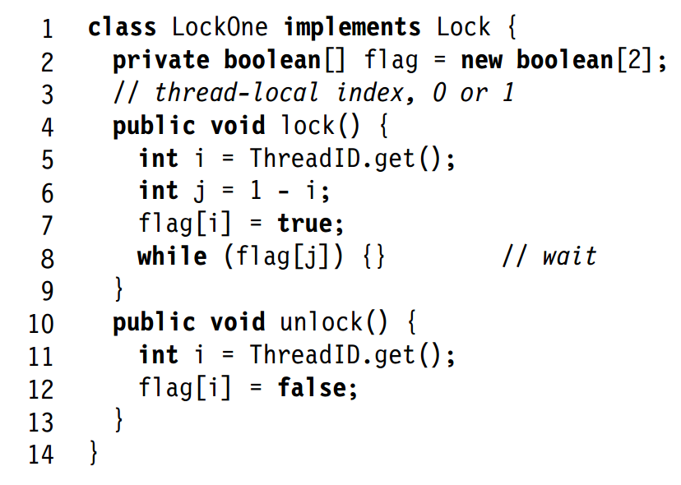
A first attempt
Algorithm satisfies mutual exclusion.
Either thread A or B does its line 7 first.
If A does 7 first, then when B does its line 8, it will see flag[A] set, and not enter CS.
So only one process in CS at a time.
Algorithm is not deadlock free.
If A and B both do line 7 before line 8, both will see the other’s flag as true, and wait forever.
Source: The Art of Multiprocessor Programming. Herlihy, Shavit
Two process lock using reads and writes.
Each thread has an ID i for itself, and j for the other process.
Set a flag to indicate interest in CS.
Wait till other thread’s flag unset to enter CS.
To leave the CS, it resets the flag.

Slide 9
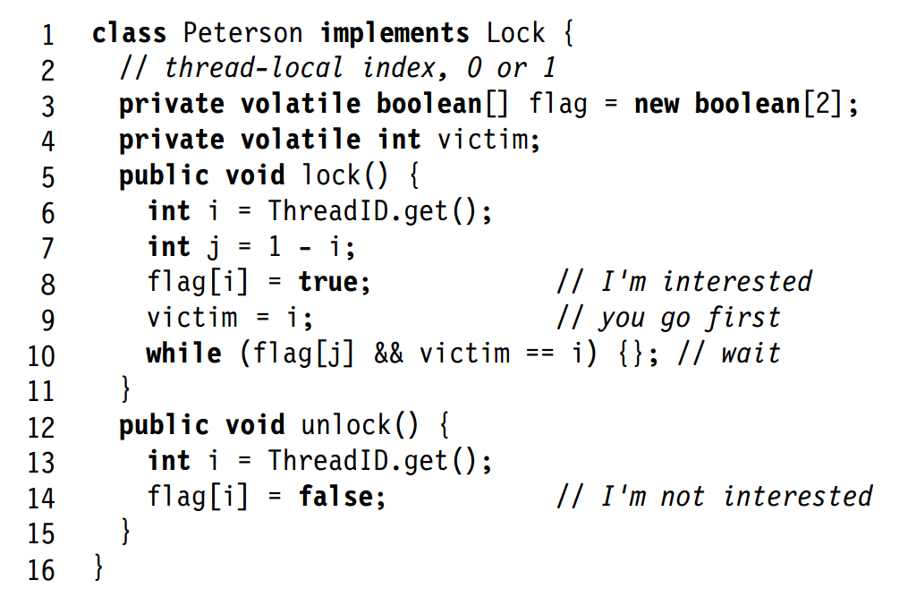
Peterson’s mutex algorithm
Mutual exclusion or deadlock-freedom can only be violated when both processes want to enter the CS.
Suppose WLOG both processes want to enter CS. Let i be the process that did line 9 last.
Algorithm satisfies mutual exclusion.
Both i, j already did line 8.
So when i does line 10, it waits for j.
Algorithm satisfies deadlock freedom.
Suppose thread i is waiting at 10.
Then flag[j] == true, so j is interested in the CS.
Since i did 9 last, victim == i, and so j is in the CS.
So eventually j will do unlock, and set flag[j] == false.
At that point, i can enter the CS.
Algorithm also wait-free.
Can build n process mutex by repeated use of 2 process mutex.
Each thread has a flag to indicate interest in CS.
There’s a shared variable victim accessed by all the theads.
When a thread wants to enter the CS, it first sets victim to itself to let the other thread go first.
A thread waits while the other thread is interested in the CS, and while the victim is itself.
To leave CS, it resets the flag.

Slide 10
Lamports’s bakery algorithm
n process mutual exclusion.
Based on each process getting a ticket, similar to lining up at the bakery or bank.
Code has two sections, doorway and waiting.
A process always finishes its doorway code in a bounded (in n) number of steps.
Satisfies first come first serve (FCFS) property:
If process i finishes its doorway before process j starts, i will enter the CS before j.
Thus, this algorithm is wait free, because each process eventually finishes its doorway section, after which it’s guaranteed to enter the CS before any process that starts the doorway later.

Slide 11
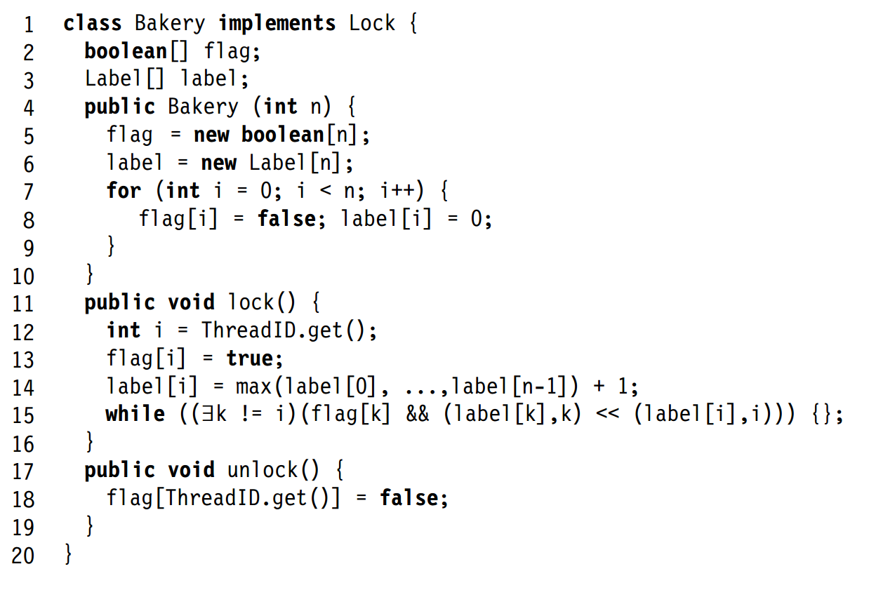
Lamport’s bakery algorithm
The algorithm is deadlock free.
At any time, some thread has the min (label, ID). That thread won’t wait to enter the CS.
The algorithm is FCFS.
If some thread i finishes line 14, then any other thread who starts its doorway (line 12) later will see i’s label and choose a larger label. Then it will wait for i at 15.
The algorithm satisfies mutual exclusion.
Suppose for contradiction both i and j are in CS. Suppose WLOG (label[j], j) > (label[i], i).
When j did line 15, it saw either flag[i] == 0 or (label[i], i) > (label[j], j).
The latter can’t happen, because i’s labels are monotonically increasing.
So flag[i] == 0, and i hasn’t done 13 yet.
But then when i does 14, it will see label[j] and choose a higher label, contradiction.
The doorway code is lines 12 to 14. Line 15 is the waiting section.
Each process has a flag to show interest in the CS, and an integer label.
Each process reads the labels of all the other processes, and sets its label to be one larger than the max.
Several threads can be reading and setting labels at the same time, and can assign themselves the same label.
Then the thread waits for all other interested threads with smaller labels to reset their flags.
Use thread ID to break ties on labels (lexicographic ordering).

Slide 12
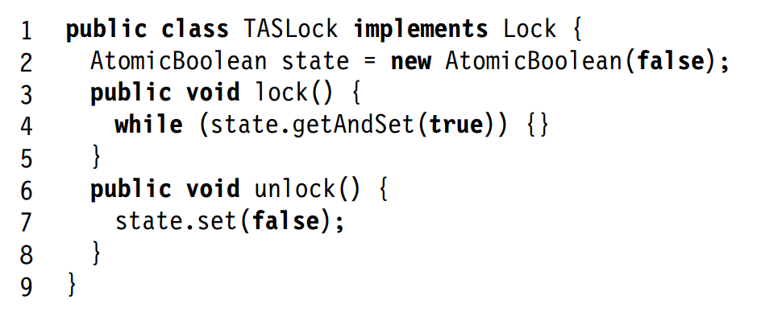
Test-and-set based locks
n process mutex algorithms are somewhat complicated.
Most also assume sequential consistency, which many processors don’t offer.
Instead, we can build simpler locks using built-in hardware primitives such as test-and-set (aka TAS, aka getAndSet).
A basic algorithm is the following.
To enter CS, a process does getAndSet on variable state.
If it’s the first to arrive at the CS, it receives return value false and enters the CS. If it’s not the first, it receives true and waits.
To exit the CS, a process resets state.
The algorithm satisfies mutual exclusion and deadlock-freedom.
It is not wait-free, because a process that wants the CS can always get true on line 4.

Slide 13
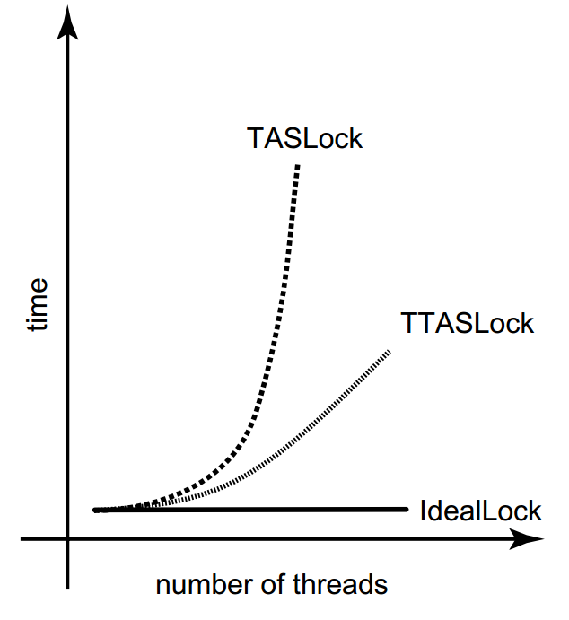
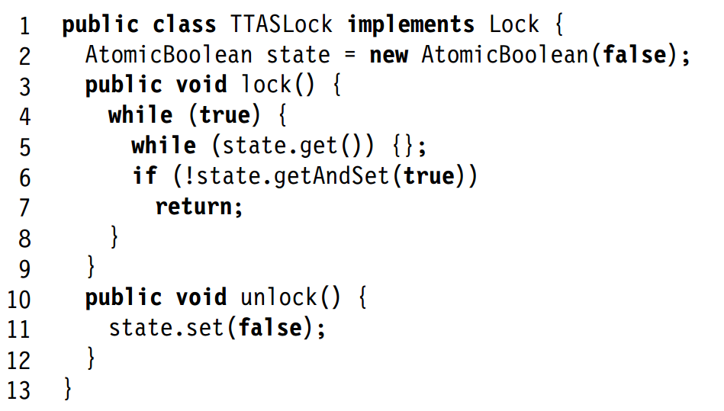
Improving performance
Simple TASLock performs poorly on multiprocessors.
Each getAndTest incurs cache coherency traffic.
Also causes processes to flush their cached copy of state, so they access memory to read state’s new value.
TTASLock uses get (read) on state instead of TS.
If it sees state == false, it uses getAndSet to try to set state.
TTASLock performs better than TASLock because the gets read the cached copy of state and don’t cause coherency traffic.
Reading cached copy of variable is called local spinning.
Only when the process in CS exits and sets state to false, or at 6 when processes contend to enter the CS, is there a cache coherency broadcast.
Thus performance still degrades with increasing number of threads, but is much better than TSLock.

Slide 14
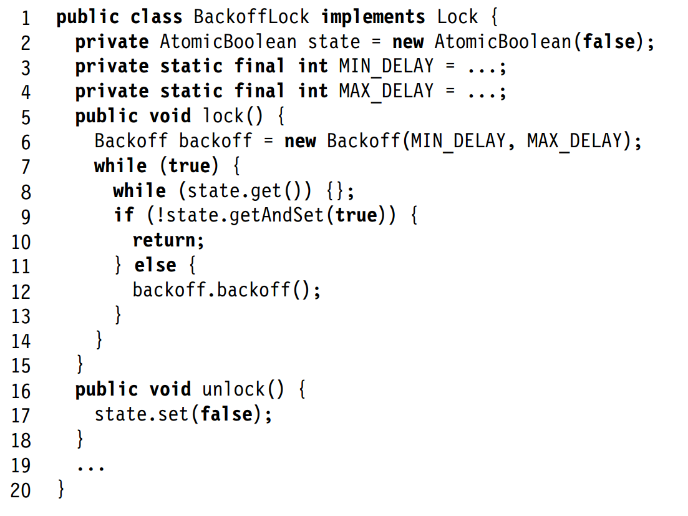
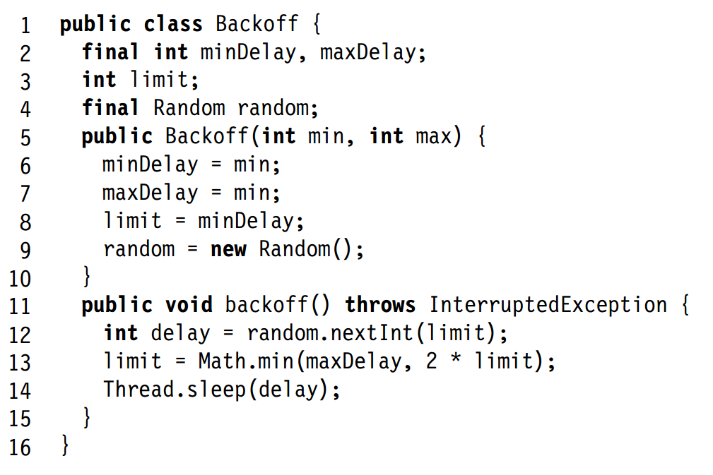
Backoff based locks
With previous algorithms, if a thread doesn’t get the lock, it keeps trying.
Since the lock won’t be available immediately anyways, we can instead make thread back off, i.e. wait before retrying.
To prevent all threads waiting same time and retrying together, back off for a random time period.
Same idea (exponential backoff) used in e.g. Ethernet.
If still fail to get lock after backoff, then double the waiting time (line 13 in Backoff).
Main question is how long to back off for.
Too short, and there are still wasted retries.
Too long, and threads unnecessarily delay themselves entering the CS.
The best backoff policy is still an active area of research.

Slide 15
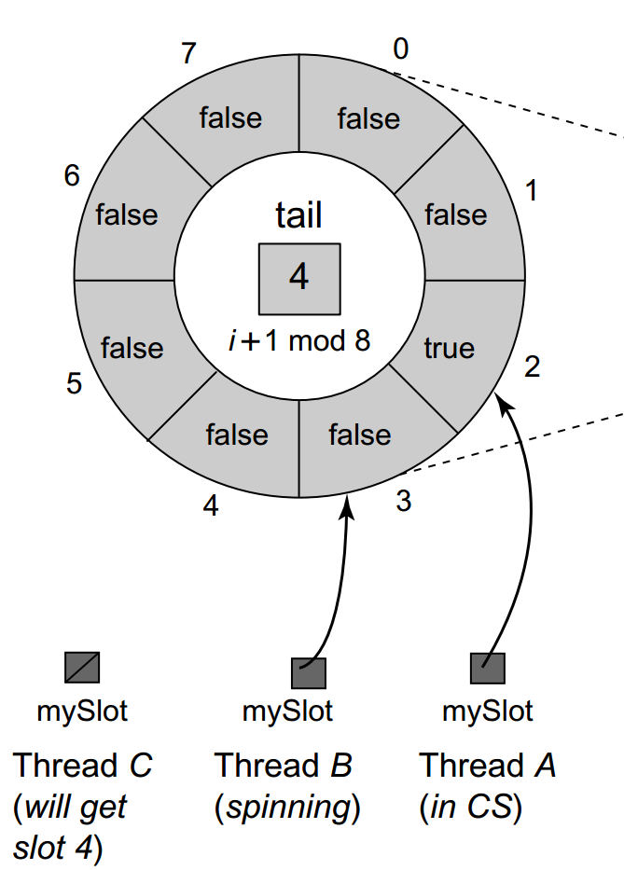
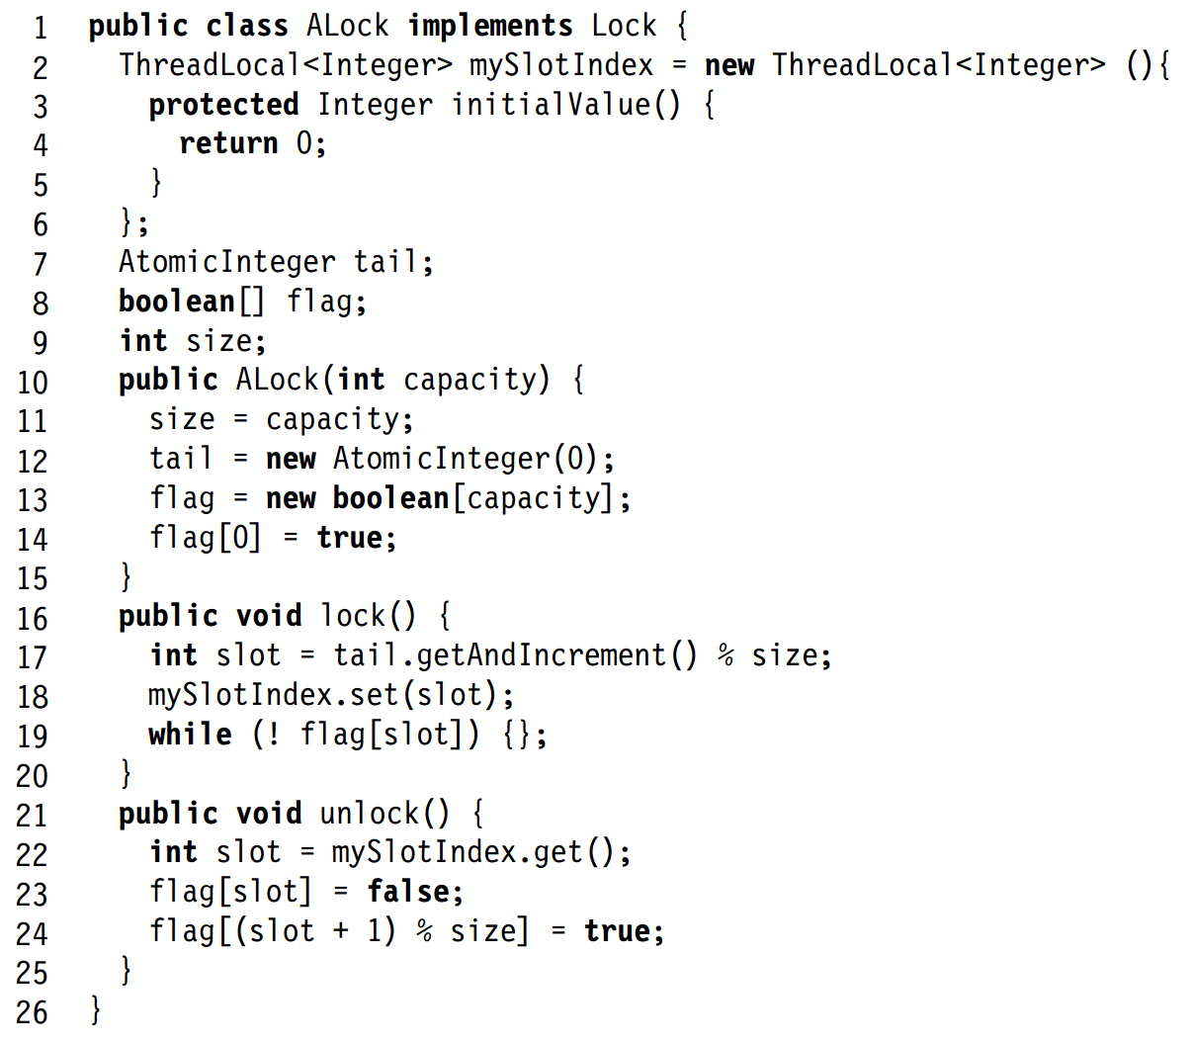
Anderson’s queue lock
Queue locks avoid backoff’s problem of having to choose the right backoff period, and avoids the TAS locks’ problems of excessive cache coherency traffic.
This queue lock algorithm requires a known upper bound size on the number of concurrent threads.
There’s a shared integer tail, initially 0, and a shared array flag.
Initially only flag[0]==true, all other flags are false.
Each thread also has its own private mySlotIndex.
To get the lock, a process atomically increments tail and gets a slot.
Then it spins on flag[slot] until it becomes true, then enters the CS.
To unset the lock, it sets its slot’s flag to false, and sets the next slot (mod size)’s flag to true.
Then the process waiting at the next slot can enter the CS.
Each thread spins on a different flag[slot].
If slot changes to slot+1, then only thread previously spinning on flag[slot+1] needs to reread flag[slot+1] from memory.
So there’s much less memory traffic and we get better performance.

Slide 16
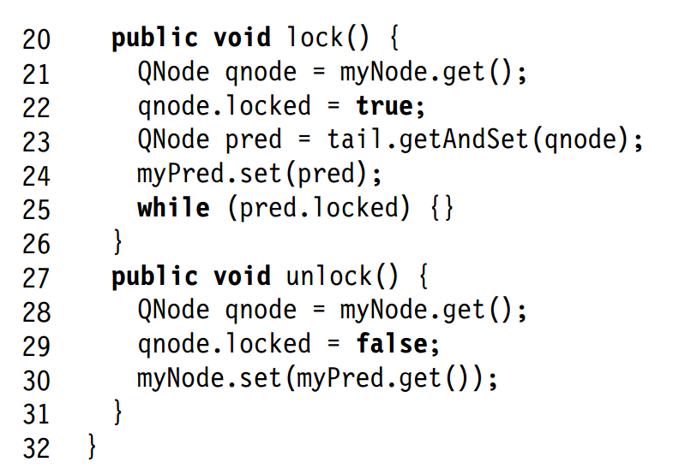
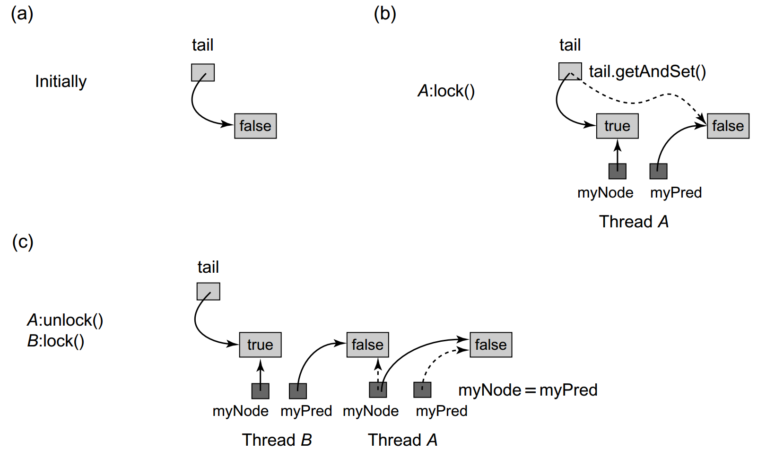
CLH queue lock
Invented by Craig, Hagersten and Landin.
ALock needs to know max number of concurrent threads.
CLH lock uses a linked list, doesn’t need to know a bound.
tail is a shared variable, and each thread has a private myNode and myPred.
Each thread wanting the lock first sets its myNode.locked to true.
Then does getAndSet on tail to set its predecessor pred to what tail was pointing at, and set tail to myNode.
So thread joins the list of nodes waiting for the lock.
Then it spins on myPred until it’s unlocked.
To unlock, a thread sets myNode.locked to false.
It also sets the node it will use the next time, i.e. myNode, to myPred.
This works because only one thread will use a node as its myNode.
Algorithm is very efficient, except in cacheless NUMA architecture.
Without cache, spinning on predecessor’s locked field incurs remote accesses.

Slide 17
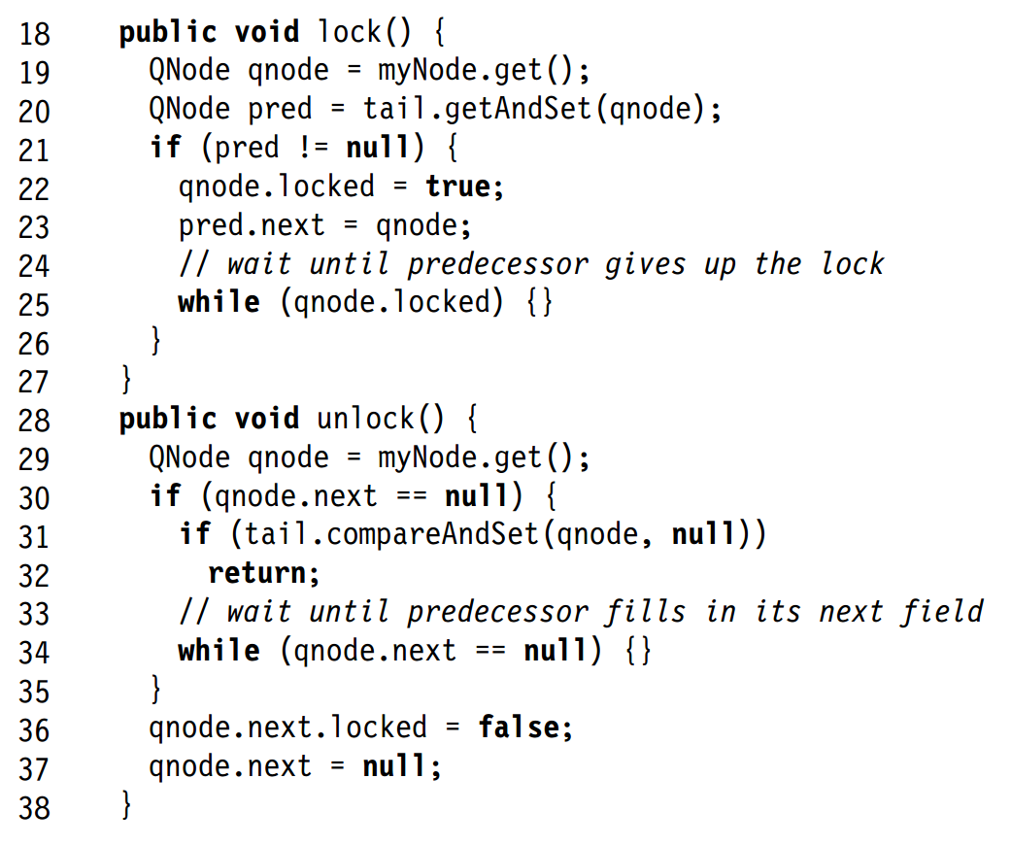
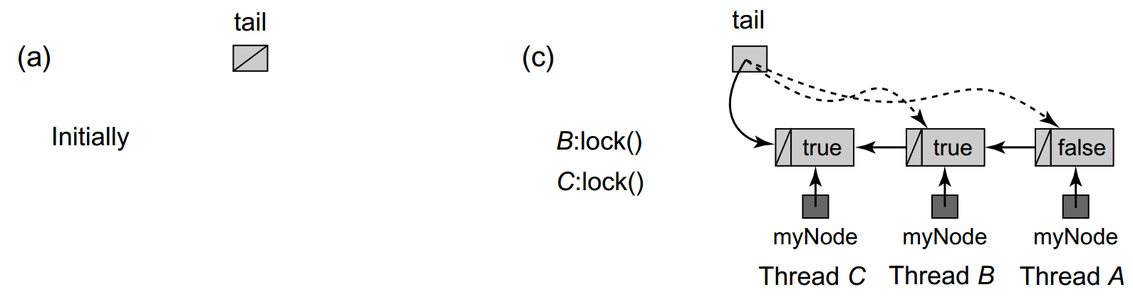
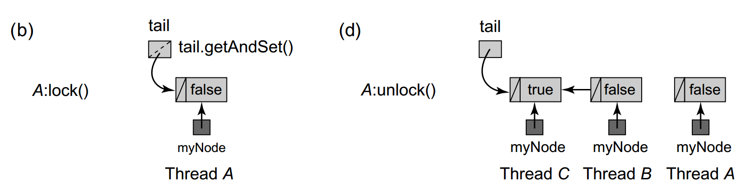
MCS queue lock
Invented by Mellor-Crummey and Scott.
As with CLH lock, there is a tail shared variable, and each thread has a private myNode and myPred.
Each node now has a next pointer to the next thread that should enter the CS after itself.
To get lock, a thread does getAndSet on tail to set its node’s predecessor to what tail was pointing at, and set tail to myNode.
If pred == null, there’s no thread in the CS, so this thread enters.
If pred != null, set predecessor’s next field to myNode.
Spin till predecessor sets myNode.locked to false, which lets this thread enter CS.
Advantage over CLHLock is that lock() spins on myNode.locked, which is a local variable and doesn’t incur network traffic.

Slide 18
MCS queue lock
To unlock, check if myNode has predecessor (i.e. a thread waiting to enter CS) by checking if myNode.next==null.
If so, then either myNode doesn’t have a predecessor, or the predecessor is slow to do line 23.
To distinguish the cases, thread does CAS(tail, myNode, null).
If tail == myNode, then there’s no predecessor.
CAS returns myNode and sets tail to null.
If tail != myNode, then there is a predecessor.
CAS returns the predecessor, and doesn’t change tail.
Wait for predecessor to identify itself, by setting myNode.next equal to its ID.
Let the predecessor (i.e. myNode.next) enter CS by setting its locked to false.
Set myNode.next to null. myNode can be reused by this thread for its next CS.
Unlocking requires spinning on nonlocal variable.
But this spinning usually short.
Compared to CLHLock, this algorithm does more reads and writes, and also uses CAS.

